Slide 1
Introduction to Functions Course Title: Programming Language II Course Code: CSE 111 Semester: Summer 2020 Lecture - 6

Slide 2
Last Lecture
range () function
Syntax
Reverse range
Concatenation
for loop/ for each loop
Syntax
Iteration of a range
Iteration over a String

Slide 3
Today’s Lecture
Introduction
Different types of functions
Built in functions
User Defined functions
Lambda functions
Recursion function
Why function?

Slide 4
Functions
A function is a block of code which only runs when it is called.
A function has 4 parts.
Function name
Parameter list
Body of the function
Return statement
There can be 4 types of functions.
User-Defined Functions
Built-In Function
Lambda Function
Recursive Function
Functions are integral part of modular programming.

Slide 5
Built-In Function
Functions that are already available to us for use in Python.
For example,
input(), print(), min(), max(), abs() etc.
To know more about built in functions follow this link .
Built in function | Feature | Example
input() | Takes user input and returns String. | s= input("Enter a number: ")
print(obj1,obj2….) | Prints specified objects in the output section. | print("Hello World.")
min(collection) | Returns the minimum value from a collection. | min([20,10,30])
max(collection) | Returns the maximum value from a collection. | max([20,10,30])

Slide 6
User Defined Functions
Custom functions that we write to fulfill our purpose.
There are two types of user-defined functions.
Void function : Functions that do not return anything after execution.
Fruitful function: Functions that return some value after execution.
In Python a function is defined using the def keyword:
To call a function, use the function name followed by parenthesis:
Output will be: Hello from a function
def my_function():
print("Hello from a function")
def my_function(): print("Hello from a function") my_function()

Slide 7
User Defined Functions
Custom functions that we write to fulfill our purpose.
A user defined function has 4 parts.
Function name
Parameter list
Body of the function
Return statement
For example,
Function name: It can be anything as long as we follow naming conventions. Function has the same naming convention as variable.
Parameter List: Optional. We use it if we want to pass some values to the function.
def compare(x,y):
max = None
if x>y:
max = x
else:
max = y
return max
print(compare(10,20))
Body of the function: Optional. The block of code that is executed when the function id called.
Return statement: Optional. After the function has finished executing it will take away a value and replace the function calling statement with that value.
Calling the function: A function only executes if we call it. We can call a function following this syntax:
Function_name (arguments)

Slide 8
Parameter and Arguments
Information can be passed into functions as arguments.
Arguments are specified as parameter list after the function name, inside the parentheses. You can add as many parameters as you want, just separate them with a comma(,):
From a function's perspective:
A parameter is the variable listed inside the parentheses in the function definition.
An argument is the value that is sent to the function when it is called.
def my_function(fname):
print("Hello",fname)
my_function("Alice")
my_function("Bob")
my_function("Carrol")
Output will be :
Hello Alice
Hello Bob
Hello Carrol

Slide 9
Number of Arguments
By default, a function must be called with the correct number of arguments. For example,
If you try to call the function with 1 or 3 arguments, you will get an error:
def my_function(name, place):
print(name+" goes to "+place)
my_function("Alice", "Shopping Complex")
Output:
Alice goes to Shopping Complex
def my_function(name, place):
print(name+" goes to "+place)
my_function("Alice")
Output:
TypeError: my_function() missing 1 required positional argument: 'place'

Slide 10
Unknown Number of Arguments (args*)
If we do not know how many arguments will be passed to your function, we can add an asterik (*) before the parameter name in the function definition.
Example-1
def my_function(*kids):
print("The first child is "+ kids[0])
my_function("Alice", "Bob", "Carrol")
Output: The first child is Alice.
Example-2
def CoronaStat(*update):
print("Corona positive:", update[0], update[1], update[2], update[3])
CoronaStat("Female:", 800, "Male:", 1000)
Output: Corona positive: Female: 800 Male: 1000

Slide 11
Keyword Arguments
We can also send arguments with the key = value syntax.
This way the order of the arguments does not matter.
def my_function(child3, child2, child1):
print("The youngest child is " + child3)
my_function(child1 = "David", child2 = "Daniel", child3 = "Nicolai")
Output: The eldest child is Nicolai

Slide 12
Default Argument Values
In function's parameter list we can specify a default value(s) for one or more arguments.
A default value can be written in the format “parameter_name = value”.
We will have the option to assign or not assign a value for those arguments.
def nsquare(x, y = 2):
return (x*x + 2*x*y + y*y)
print("The square of the sum of 2 and 2 is : ", nsquare(2))
print("The square of the sum of 2 and 3 is : ", nsquare(2,4))
Output: The square of the sum of 2 and 2 is: 16
The square of the sum of 2 and 4 is : 36

Slide 13
‘return’ statement
To let a function return a value, use the return statement.
The returned value replaces the function calling statement.
Example: 1
def multiply(x):
return 5 * x
print(multiply(3), end= " ")
print(multiply(5), end= " ")
print(multiply(9))
Output: 15 25 45
Example: 2
def nsquare(x, y):
return (x*x + 2*x*y + y*y)
print("The square of the sum of 2 and 3 is : ", nsquare(2, 3))
Output: The square of the sum of 2 and 3 is : 25

Slide 14
Pass and Lambda Function
Function definitions should not be empty, but if you for some reason have a function definition with no content, put in the pass statement to avoid getting an error.
In Python, small anonymous (unnamed) functions can be created with lambda keyword. Lambda forms can be used as an argument to other function where function objects are required but syntactically they are restricted to a single expression. A function like this:
may also be defined using lambda
def myfunction(): pass
def average(x, y):
return (x + y)/2
print(average(4, 3))
print((lambda x, y: (x + y)/2)(4, 3))
Output: 3.5

Slide 15
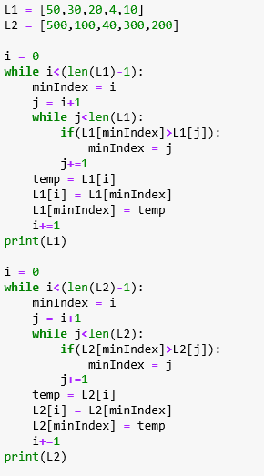
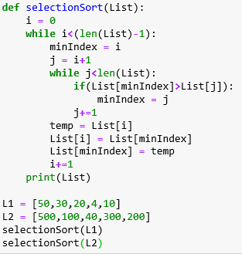
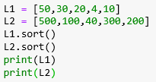

Why function??
Suppose you are given two lists. You have to sort these lists in ascending order.
Solution: 1
Solution: 2
Solution: 3

Slide 16
Summary
A function is a block of code that runs when it is called.
There are lots built in function functions in python to make our life easier.
Sometimes we need functions for our customized purpose. Then we create user define functions.
User defined functions have 4 parts.
Function name
Parameter List
Body
Return Statement
If we have a block of code that we need to execute several times, we put that block of code inside of
a function.

Slide 17
Next Lecture
Introduction
Indexing
Mutability of String
Basic String operations
Concatenation
Deletion
Repetition
Slicing

Slide 18


